Slide 1

Ethical Hacking: Penetration Testing
Satyam Tiwari (1024030088)
ELC 2526 EVENSEM
Thapar Institute of Engineering & Technology

Slide 2

Lab Environment & Infrastructure
Parameter | Attacker (Kali) | Victim (Metasploitable)
IP Address | 192.168.56.101 | 192.168.56.103
RAM / CPU | 4096 MB / 2 | 512 MB / 1
Network | Host-only | Host-only

Slide 3

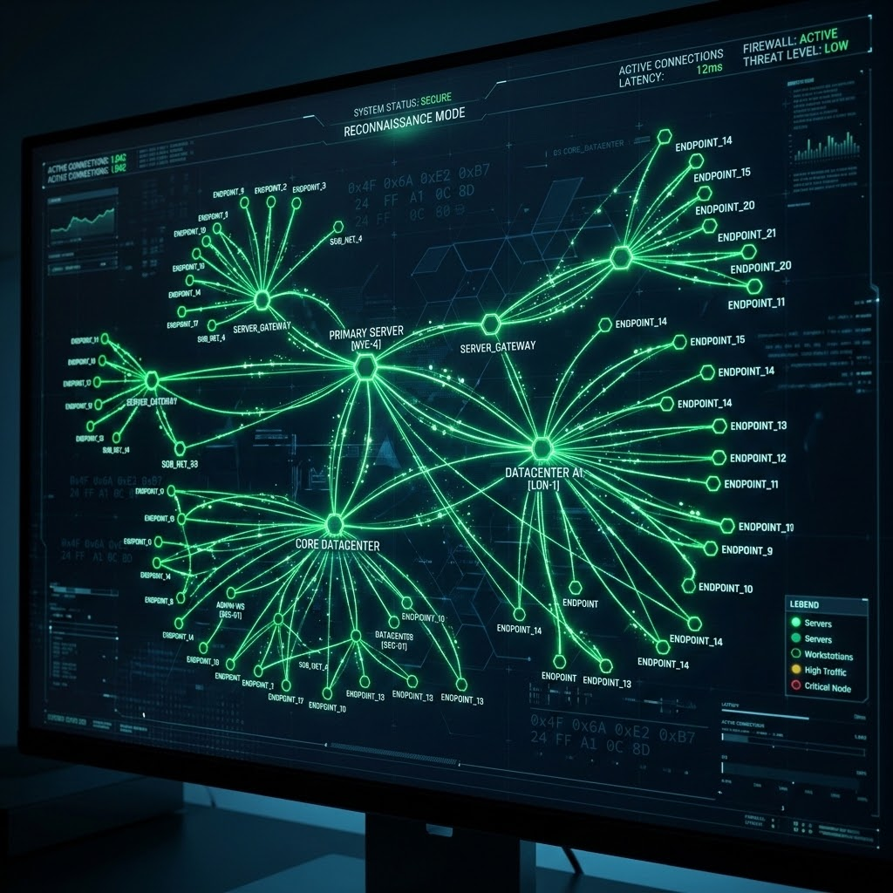

1.1 Reconnaissance: Host Discovery
Network Sweep
An initial ping sweep was conducted using Nmap to verify network connectivity and identify active targets within the subnet.
nmap -sn 192.168.56.0/24
Confirmed Victim active at .103
Subnet block mapped successfully

Slide 4
1.2 Service Mapping & Port Analysis
Port | State | Service | Version / Analysis
23/tcp | Open | Telnet | Linux telnetd (Insecure admin)
25/tcp | Open | SMTP | Postfix smtpd (Mail delivery)
445/tcp | Open | Samba | smbd 3.X-4.X (File sharing)
5432/tcp | Open | PostgreSQL | v8.3.0 - 8.3.7
5900/tcp | Open | VNC | Protocol 3.3 (Desktop sharing)

Slide 5

1.3 Successful Credential Attacks
Automated Auditing (Hydra)
2
Leveraged fasttrack.txt to identify weak default credentials across infrastructure services.
PostgreSQL: postgres / postgres
Confirmed Breaches
Samba: user / user

Slide 6





Technical Constraints & Hardening
Telnet Limits
SMTP Auth
VNC Security
Default account msfadmin resisted brute-force, indicating non-standard password entropy.
Mail relay daemon returned 503 error; authentication extensions are explicitly disabled.
Security mismatch detected (Result 2). Server dropped multi-threaded attempts.

Slide 7


1.4 Proposed Security Improvements
Credential Rotation: Enforce 16+ character complexity for admin accounts.
Protocol Deprecation: Disable Telnet/VNC; replace with SSH key-auth.
Network Firewalling: Use iptables to restrict Port 5432 and 445 access.
SMTP Security: Enable SASL auth and restrict anonymous relay capabilities.

Slide 8

Task 2: Framework Exploitation
vsFTPd 2.3.4 Backdoor
Targeted a historic supply-chain backdoor (CVE-2011-2523) in the FTP daemon.
Vector: unix/ftp/vsftpd_234_backdoor
Trigger: Username ending in ":)"
Result: Shell spawned on Port 6200

Slide 9


Post-Exploitation Control
Full System Takeover
Meterpreter Shell: Upgraded raw shell to structured management.
UID: root (Highest privileges achieved).
Persistence: Verified full read/write access to filesystem.

